Slide 1
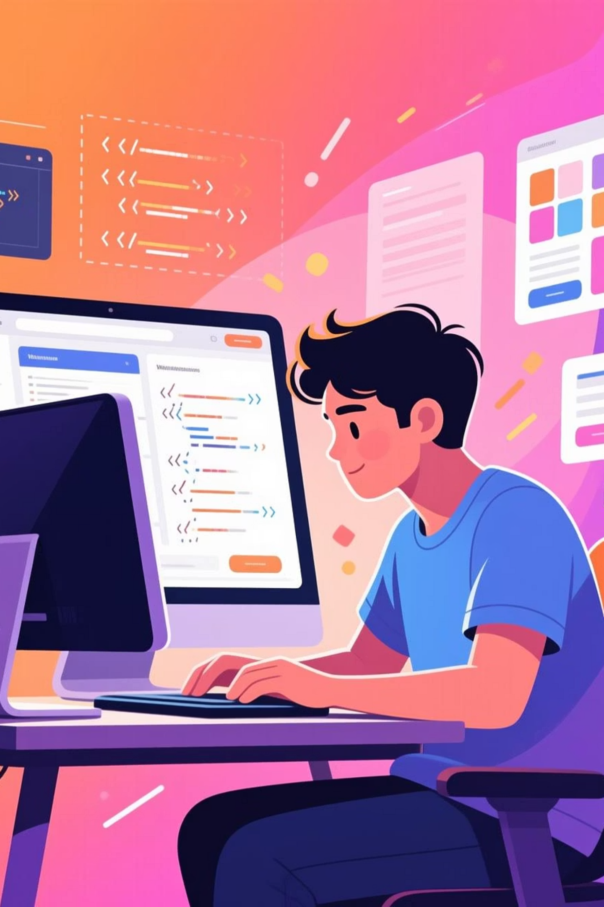
Online Portfolio Website
This project is designed to help students and professionals establish their digital presence.
Project Details
Student Name: Lagad Aditya Sandip
Guide: Prof. T. S. Thange
Course: S.Y. B.Sc. (Computer Science) — Field Project
Through this website, individuals can effectively showcase their skills, education, and achievements, building a strong online identity.

Slide 2

Introduction
Comprehensive Display
Global Accessibility
The Online Portfolio Website effectively showcases personal, academic, and professional details in a clear and visually engaging format.
Functions as a dynamic digital resume, readily accessible anytime and anywhere, ensuring your credentials are always at hand.
Enhanced Online Presence
Modern Web Technologies
Establishes a robust online identity, crucial for professional growth and increasing visibility within your chosen field.
Developed using cutting-edge web technologies, guaranteeing smooth performance and a fully responsive user experience.
Cross-Device Compatibility
Engineered to work flawlessly across all devices, including mobile phones, tablets, and desktop computers.

Slide 3

Objectives
Professional Website Development
Mastering Web Technologies
Design and develop a professional, responsive, and interactive portfolio website.
Gain practical experience with HTML, CSS, JavaScript, and PHP.
Dynamic & Updatable Portfolio
Skill Enhancement
Create a dynamic, easily updatable personal portfolio.
Enhance technical, creative, and design skills through real-world application.
Self-Branding & Visibility
Responsive Design Implementation
Promote self-branding and professional visibility.
Implement responsive web design for improved user experience.

Slide 4
Methodology & Tools
Approach: Software Development Life Cycle (SDLC)
1
Requirement Analysis
2
Design
3
Development
Identifying and documenting project sections: Home, About, Skills, Projects, and Contact.
Creating the website's visual layout, theme, and user interface using HTML and CSS principles.
Implementing functional features and interactive elements with JavaScript, PHP, and MySQL.
4
Testing
5
Deployment
Ensuring cross-browser compatibility, responsiveness, and fixing any identified issues.
Publishing the completed portfolio website, hosted via platforms like GitHub Pages or XAMPP.
Tools & Technologies
Frontend: HTML, CSS, JavaScript
Backend: PHP, MySQL
IDE: Visual Studio Code
Hosting: GitHub Pages / WAMP / XAMPP
Time Frame
Approximately 60 hours will be dedicated to the project.

Slide 5

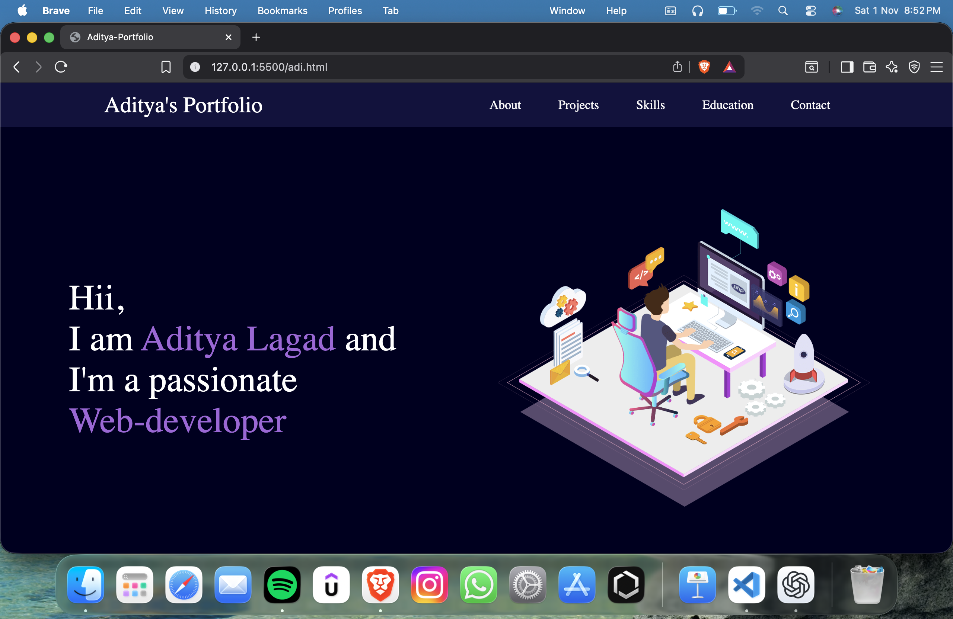
Home page

Slide 6
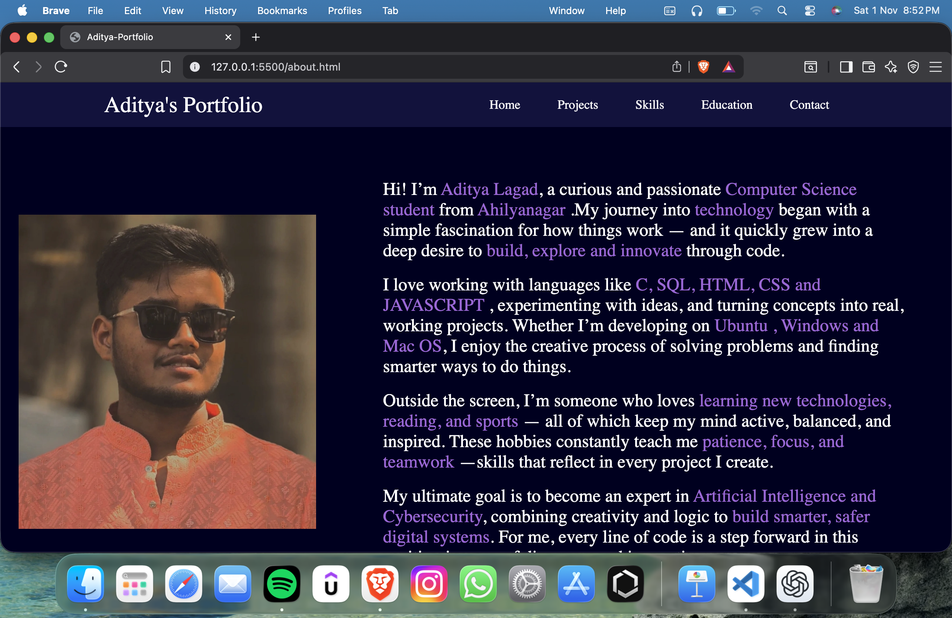
About page

Slide 7
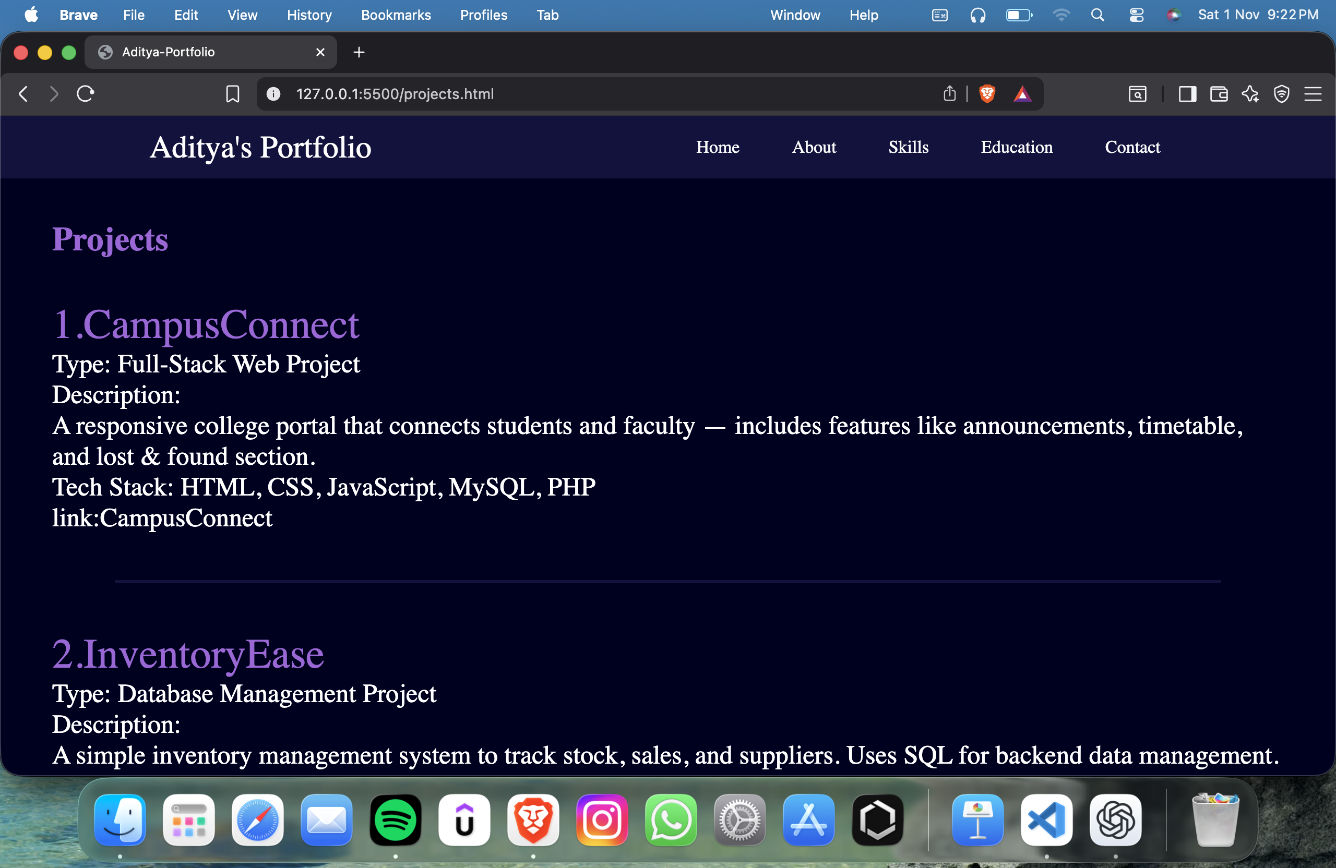
Project page

Slide 8
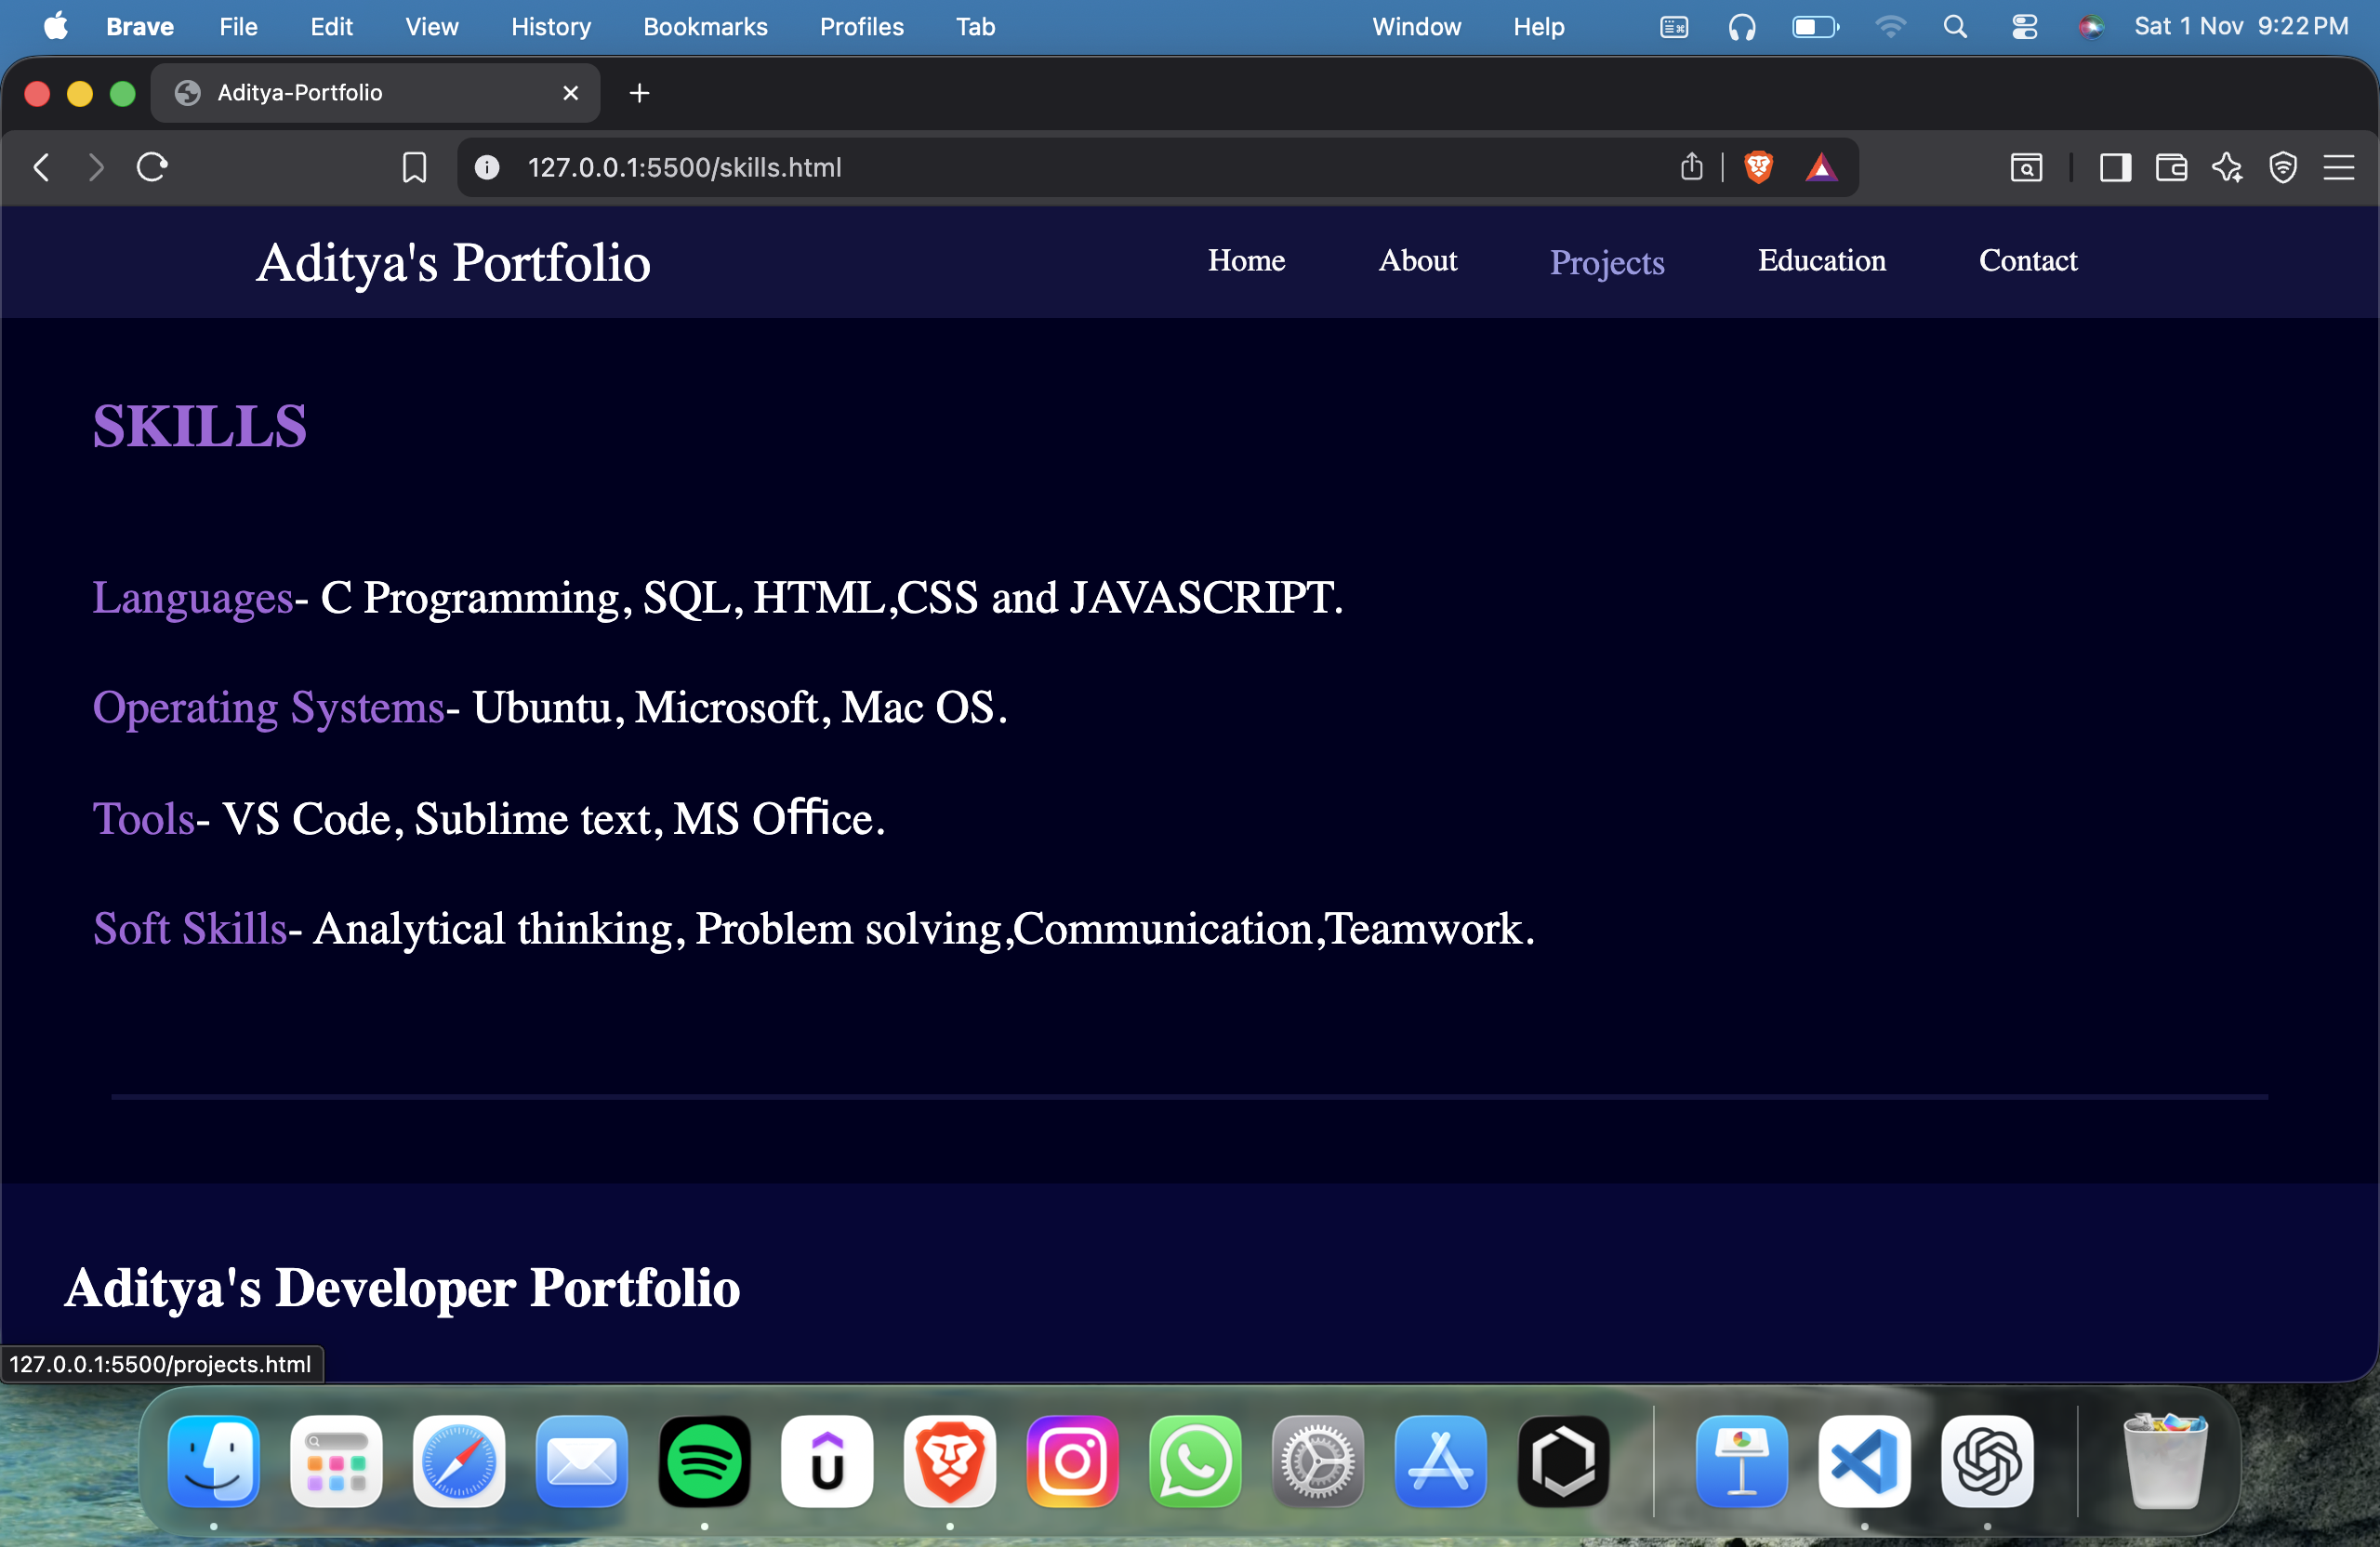
Skills page

Slide 9

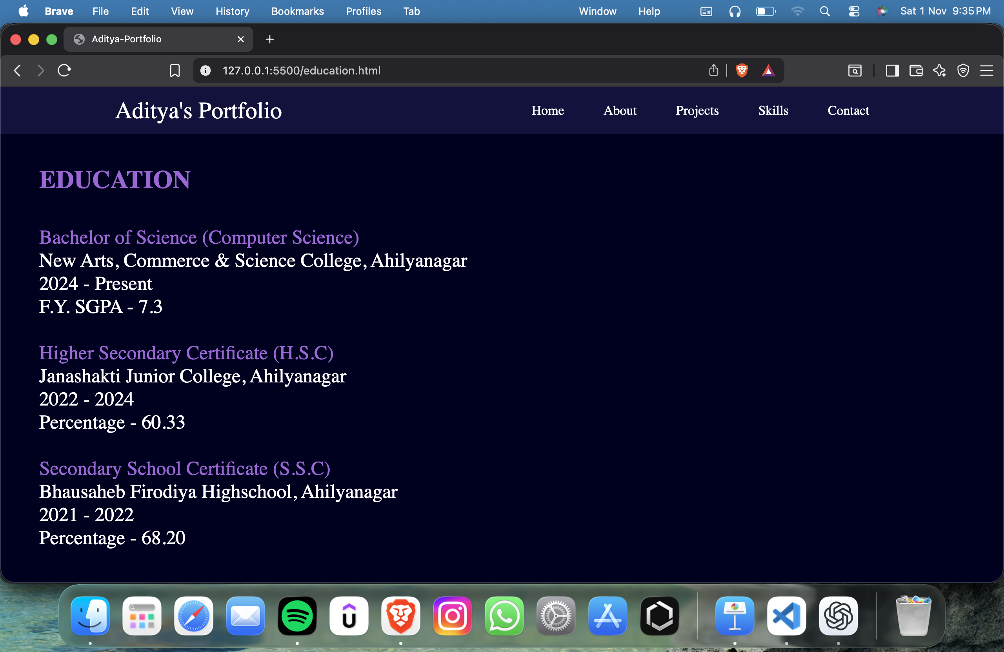
Education page

Slide 10
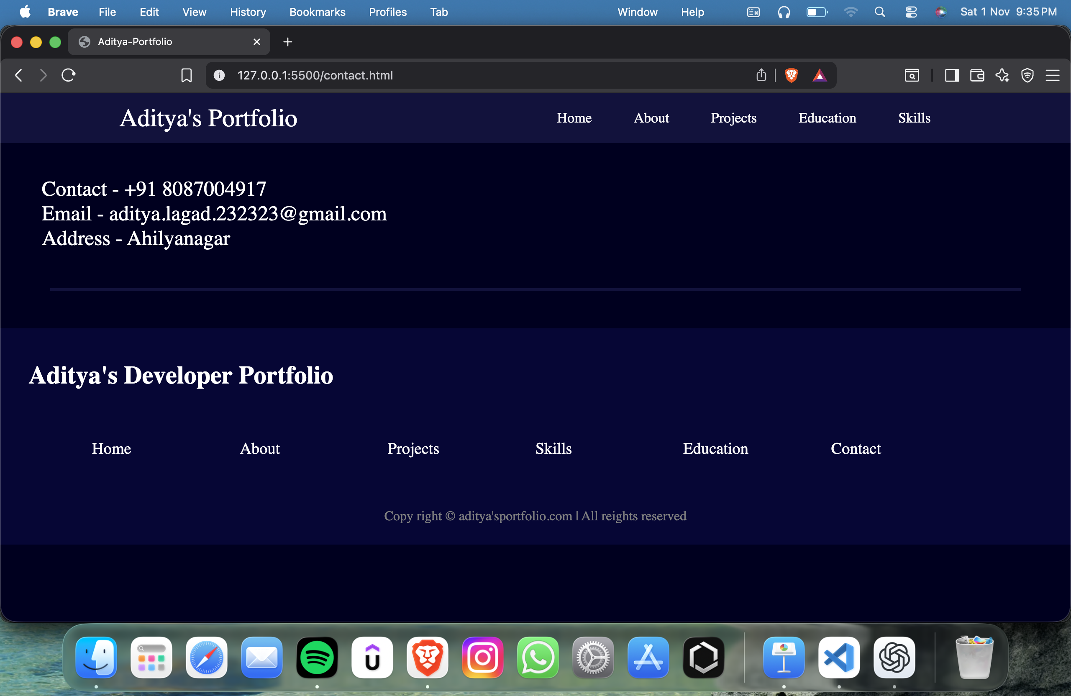
Contact page

Slide 11
Output / Results
A fully functional and responsive portfolio website was successfully developed, showcasing a professional and modern design across various sections.
Home Section
About Section
Introduces the user with a personal profile photo and a brief overview.
Details personal information, interests, and career goals.
Education Section
Skills Section
Highlights academic achievements and qualifications.
Showcases both technical proficiencies and essential soft skills.
Projects Section
Contact Section
Presents a portfolio of academic and personal projects.
Features an interactive contact form powered by PHP for user communication.
Thorough testing was conducted across various devices and browsers, ensuring smooth navigation, optimal display, and quick loading times for all users.

Slide 12
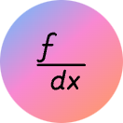



Conclusion
This project provided significant insights and practical skills in web development, translating theoretical knowledge into a tangible outcome.
Key Learnings
Seamless Integration
Full-Stack Proficiency
Design & User Experience
Practical Application
Enhanced understanding of frontend and backend integration complexities.
Gained hands-on experience in full-stack web development methodologies.
Improved design thinking, responsiveness, and overall user experience principles.
Successfully applied theoretical knowledge in a real-world scenario.
Future Enhancements
Content Expansion
Adaptive Interface
Intelligent Interaction
Add a blog or dedicated project updates section for continuous engagement.
Implement a dark/light mode switch for improved user preference and accessibility.
Integrate an AI-based resume analyzer or chatbot for enhanced user interaction.

Slide 13

Thank You!
We sincerely appreciate your time and attention to our Online Portfolio Website project. We hope this presentation provided valuable insights into its development and potential.
Feel free to connect with us for any further inquiries or collaboration opportunities.
Lagad Aditya Sandip: LinkedIn Profile

